Slide 1

Analyzing Customer Purchasing Behavior
Marketing Analytics and Research
Team 1
Aditya Akole
Bhavya Gursahani
Kunwar Sahib Singh Vohra
Yash Bansal
Notes:
After exploring a lot of datasets, we chose to pursue traditional brick and mortar retail industry.

Slide 2
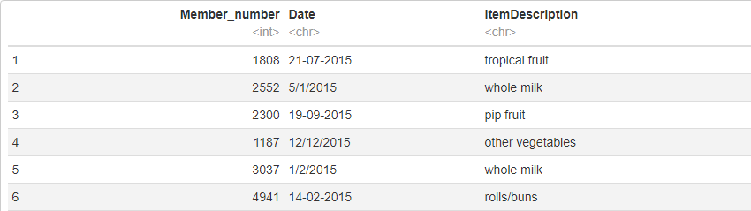
An overview of the Dataset

Slide 3
We are trying to understand customer shopping behavior
Product Placement
Bundle Purchase Offers
Marketing Promotions
Channel Optimization
Increase sales

Slide 4
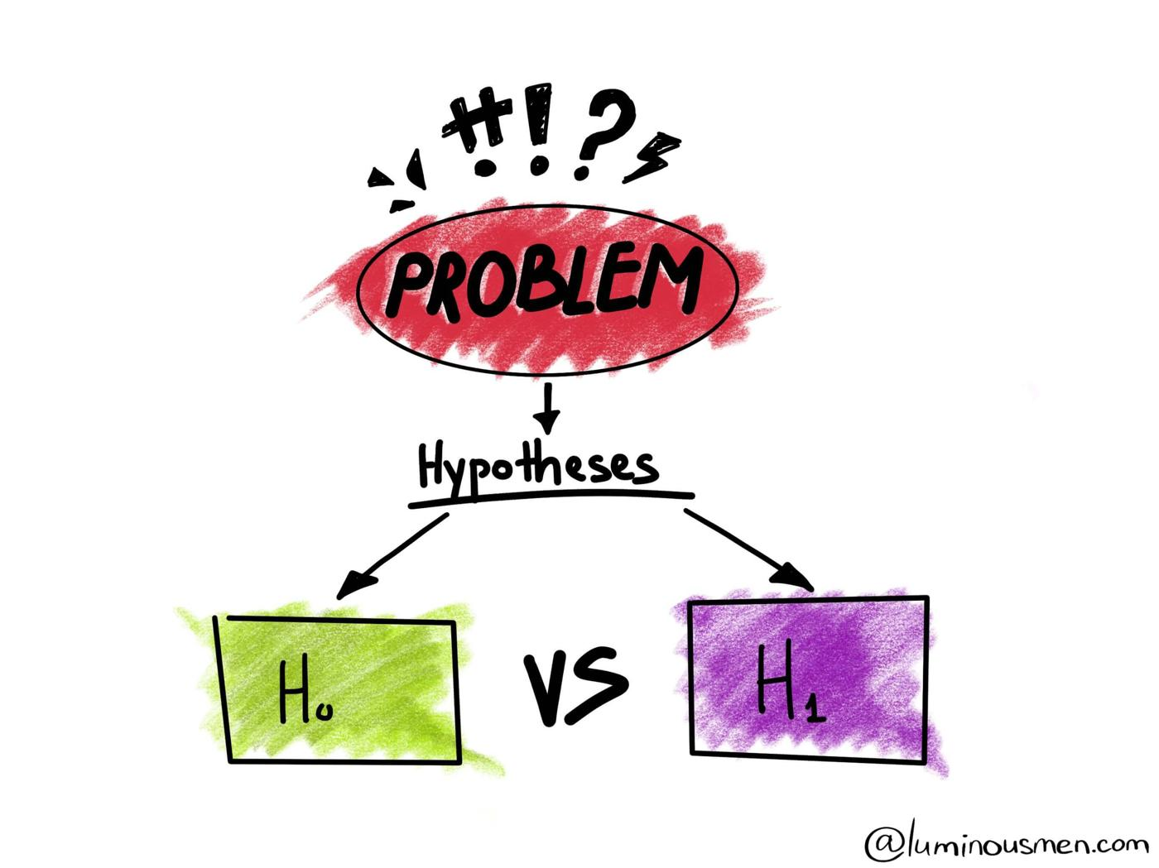
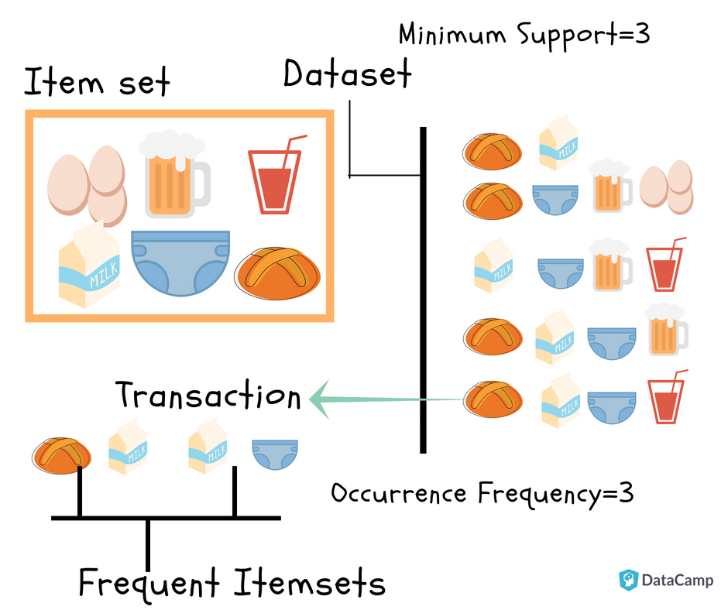
The following techniques will be used to analyze the problem
1. Hypothesis 2. Market Basket
Testing Analysis

Slide 5


We used various tools to clean, explore and analyze the data
Data Cleaning
Trend Analysis
Data Exploration

Slide 6
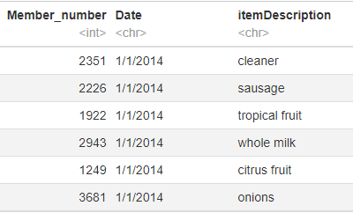
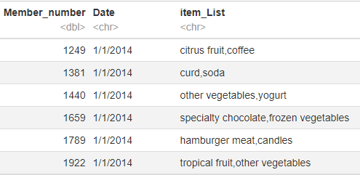
We standardized the data and prepared itemized lists for MBA
1. Standardizing Date Column 2. Itemized Lists of Products

Slide 7
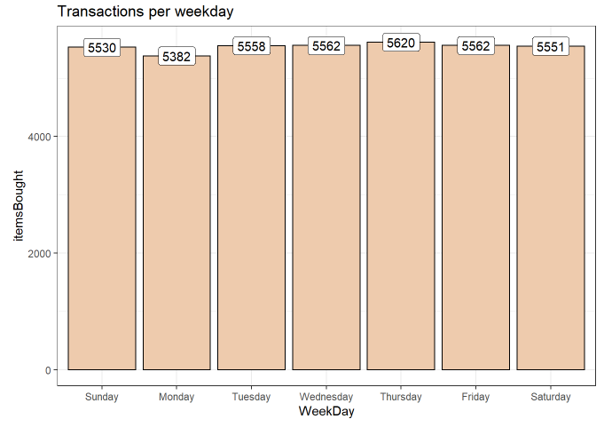
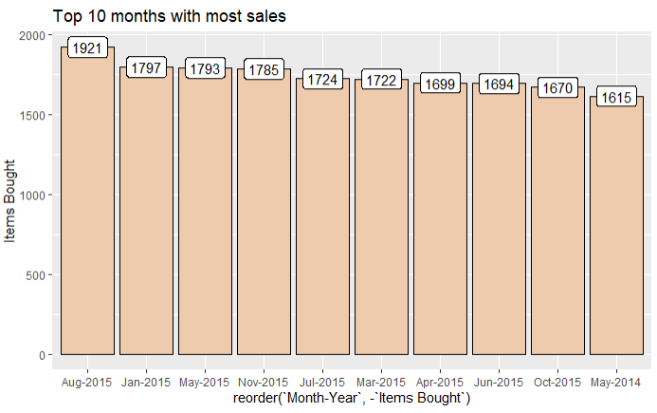
Basic Data Exploration
38765 Records
3898 Members
728 Days
167 Unique Products

Slide 8
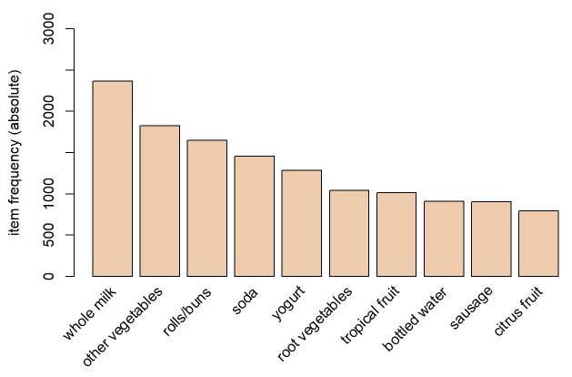
We also analyzed the frequency of each product sold in store

Slide 9
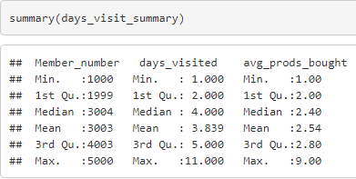
…and the summary of customer visits and products sold

Slide 10
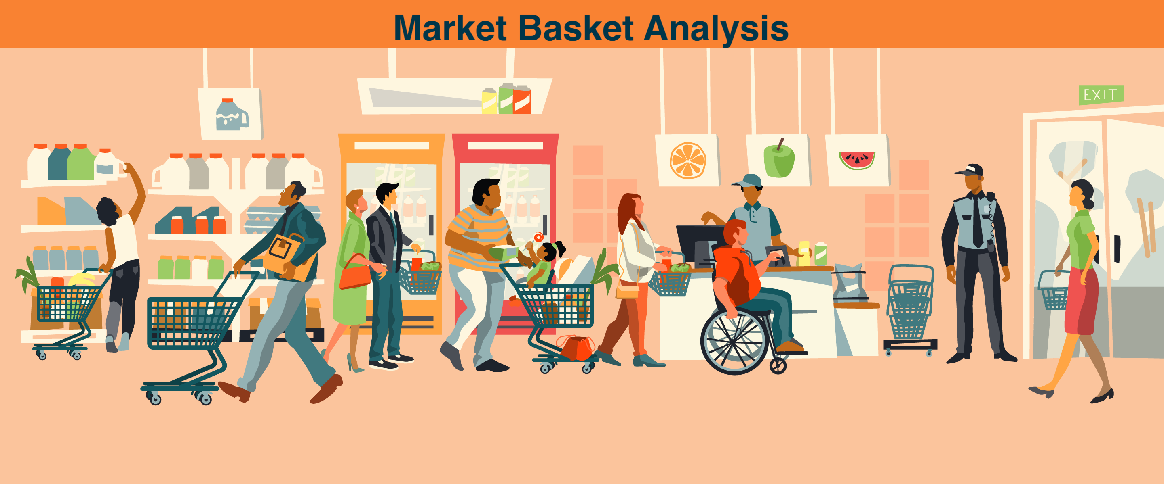
Market Basket Analysis

Slide 11
Libraries and Algorithms Used
Data Aggregation
Association Rules
APRIORI Algorithm
T-test

Slide 12
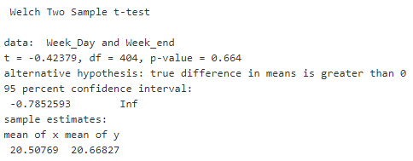
Hypothesis Testing
Null Hypothesis (Ho):
The number of people visiting the store are greater on the weekdays than the weekends.
Notes:
Null Hypotheses –

Slide 13
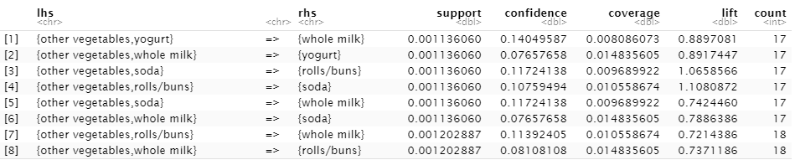
APRIORI Algorithm
Notes:
The APRIORI algorithm works with two major rules
Generate Frequent Itemset – All the frequent itemset where support is greater than the minimum support which is stated are chosen and taken out.
Rule Generation – We take all the rules from frequent itemset generation. Then we check support and confidence for all rules and remove the rules which do not satisfy the threshold.
Generation of all the frequent itemset is computationally expensive. The underlying statement which helps APRIORI sort values is that any subset of the frequent itemset should also be a frequent itemset. Hence no superset of any infrequent itemset is tested or taken into consideration.
Generation of all the frequent itemset is computationally expensive. The underlying statement which helps APRIORI sort values is that any subset of the frequent itemset should also be a frequent itemset. Hence no superset of any infrequent itemset is tested or taken into consideration.

Slide 14
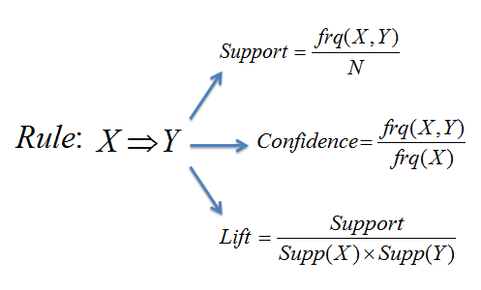
Parameters of APRIORI Algorithm

Slide 15
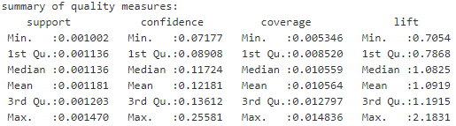
APRIORI is used to find the ideal number of products in combo

Slide 16
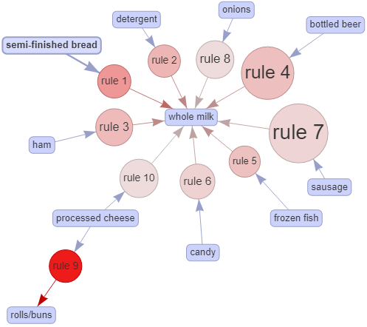
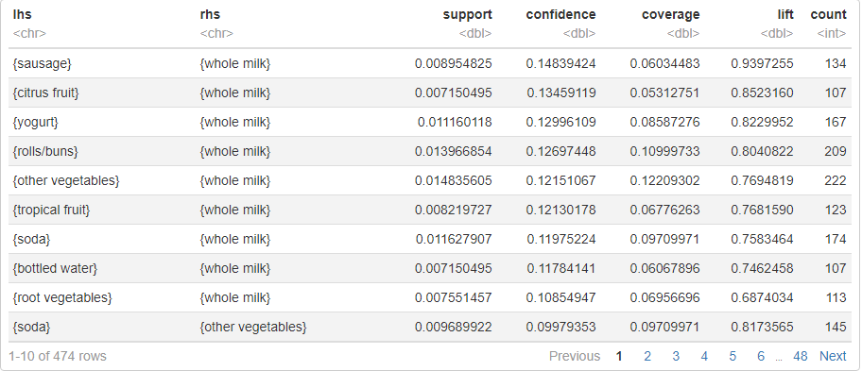
APRIORI algorithm gives us association between items

Slide 17
APRIORI was used to identify Product combos for promotions
Lift = 1.1148993
Whole Milk
Semi-Finished Bread
Buttermilk
Other Vegetables
Frankfurter
Pastry
Rolls/Buns
Processed Cheese
Beef
Lift = 0.6019608
Lift = 1.1162242
Lift = 0.5820106
Lift = 1.3158214
Lift = 0.4295022

Slide 18
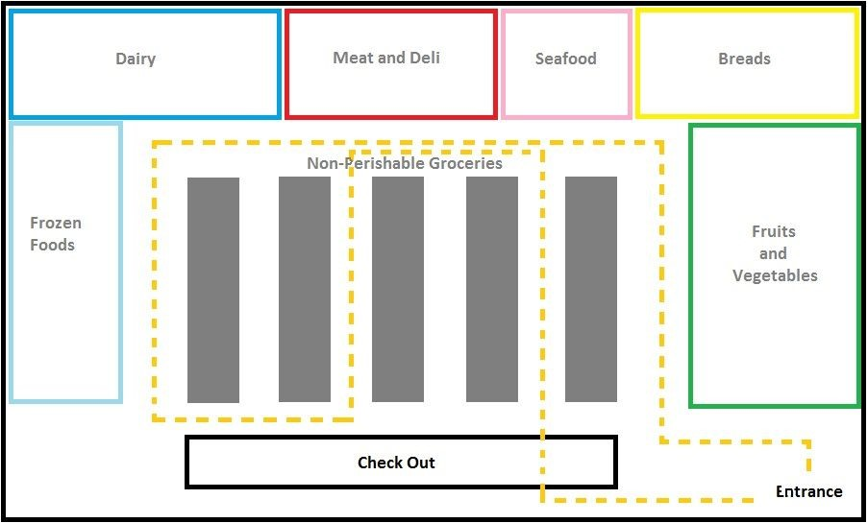
APRIORI was also used to identify Product Placements

Slide 19

The store should offer premium membership to regulars
Point Based
Offered to top 25% of customers.
730 frequent customers out of 3898

Slide 20
Recommendations
3 product combos to boost sales:
(Whole Milk, Semi-Finished Bread, Buttermilk)
(Other Vegetables, Frankfurter, Pastry)
(Rolls / Buns, Processed Cheese, Beef)
Product Placement
Whole Milk - Canned fruits & salad dressing - Other vegetables
Whole Milk – Soda - Sausages & Rolls / Buns
{Sausages, Yogurt} > Whole Milk | {Rolls / buns} > other vegetables
Increase price of Whole Milk, Other Vegetables and Rolls/ Buns
Negotiate deals with the vendors of top 10 best-selling products
New product launches on Weekends
Premium membership for top frequent customers

Slide 21
Way Forward
Deeper analysis could be performed from this analysis by using additional data such as product costs, profit margin and quantity of items sold.
We recommend observing the data for the sales through 3 months and revalidate the hypothesis of product promotions through statistical testing methods (t-test, welch test, chi-squared test, Z test)
We can modify the existing product promotion offers and introduce new offers.

Slide 22

Thank You

